Slide 1

ECE 2700
Digital Circuits
Datapath Component Tradeoffs
Copyright © 2010 Frank Vahid
Instructors of courses requiring Vahid's Digital Design textbook (published by John Wiley and Sons) have permission to modify and use these slides for customary course-related activities, subject to keeping this copyright notice in place and unmodified. These slides may be posted as unanimated pdf versions on publicly-accessible course websites.. PowerPoint source (or pdf with animations) may not be posted to publicly-accessible websites, but may be posted for students on internal protected sites or distributed directly to students by other electronic means. Instructors may make printouts of the slides available to students for a reasonable photocopying charge, without incurring royalties. Any other use requires explicit permission. Instructors may obtain PowerPoint source or obtain special use permissions from Wiley – see http://www.ddvahid.com for information.

Slide 2
Today’s Objective
To learn how to build faster but bigger (or smaller but slower) datapath components
  Carry lookahead adder
  Add-and-shift multiplier

Slide 3
Building a Faster Adder
Carry-ripple adder
  Similar to adding by hand
  Con: Slow
    Output is not correct until the carries have rippled to the left – critical path
    4*2 = 8 gate delays
  Pro: Small
    4*5 = 20 gates
a3 b3
a2 b2
a1 b1
a0 b0
cin
4-bit adder
c
out
s3
s2
s1
s0
ca
rr
ies:
c3
c2
c1
cin
B:
b3
b2
b1
b0
A:
+
a3
a2
a1
a0
cout
s3
s2
s1
s0
a3
b3
a2
b2
a1
b1
a0
b0
ci
F
A
F
A
F
A
F
A
c
o
s3
s2
s1
s0

Slide 4
Building a Faster Adder
Carry-ripple is slow but small
  8-bit: 8*2 = 16 gate delays, 8*5 = 40 gates
  32-bit: 32*2 = 64 gate delays, 32*5 = 160 gates
Two-level logic adder is fast but big
  8-bit: 8,000 transistors
  32-bit: 100 billion transistors

Slide 5
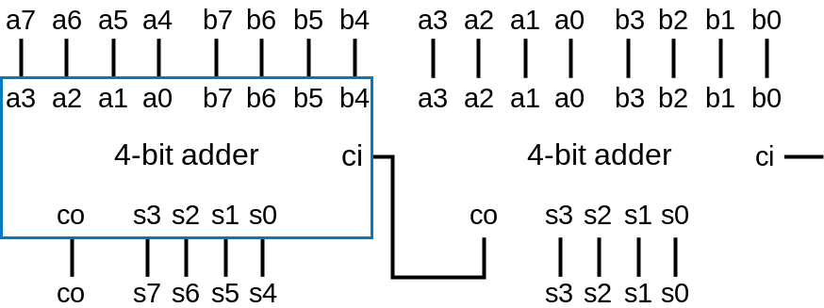
Building a Faster Adder
Compromise
  4-bit adder using two-level logic, compose to build N-bit adder
    8-bit adder: 2*(2 gate delays) = 4 gate delays, 2*(100 gates) = 200 gates
    32-bit adder: 8*(2 gate delays) = 32 gate delays, 8*(100 gates) = 800 gates
Can we do better?

Slide 6
Naïve Faster Adder
Idea: modify carry-ripple adder
  For a stage’s carry-in, don’t wait for carry to ripple, but rather directly compute from inputs of earlier stages
    Called “lookahead” because current stage “looks ahead” at previous stages rather than waiting for carry to ripple to current stage
No rippling of carry
a3
a3
b3
b3
a2
a2
b2
a1
a1
b1
b1
a0
b0
a0
c0
b2
b0
ci
look
look
look
ahead
ahead
ahead
F
A
c3
F
A
c2
F
A
c1
F
A
c0
F
A
c
o
s3
s2
s1
s0
c4
stage 3
stage 2
stage 1
stage 0
c
out
s3
s2
s1
s0

Slide 7
Naïve Fast Adder: Details
Want each stage’s carry-in bit to be function of external inputs only (a’s, b’s, or c0)
Full-adder
  s = a xor b xor c
  c = bc + ac + ab
c1 = co0 = b0c0 + a0c0 + a0b0
c2 = co1 = b1c1 + a1c1 + a1b1
c2 = b1(b0c0 + a0c0 + a0b0) + a1(b0c0 + a0c0 + a0b0) + a1b1
c2 = b1b0c0 + b1a0c0 + b1a0b0 + a1b0c0 + a1a0c0 + a1a0b0 + a1b1
c3 = co2 = b2c2 + a2c2 + a2b2
(continue plugging in...)

Slide 8
Naïve Fast Adder: Implementation
a3
b3
a2
b2
a1
b1
a0
b0
c0
No waiting for ripple
Problems
  Equations get too big
  Not efficient
  Need a better form
  of lookahead
look
look
look
ahead
ahead
ahead
c3
c2
c1
c0
F
A
c4
stage 3
stage 2
stage 1
stage 0
c
out
s3
s2
s1
s0
c1 = b0c0 + a0c0 + a0b0
c2 = b1b0c0 + b1a0c0 + b1a0b0 + a1b0c0 + a1a0c0 + a1a0b0 + a1b1
  c3 = b2b1b0c0 + b2b1a0c0 + b2b1a0b0 + b2a1b0c0 + b2a1a0c0 + b2a1a0b0 + b2a1b1 + a2b1b0c0 + a2b1a0c0 + a2b1a0b0 + a2a1b0c0 + a2a1a0c0 + a2a1a0b0 + a2a1b1 + a2b2

Slide 9
Efficient Lookahead
cin
c0
car
r
ies
:
c4 c3 c2 c1 c0
c1
1
0
1
1
1
1
1
1
b0
B
:
b3
b2
b1
b0
1
1
0
1
a0
A
:
+
a3
a2
a1
a0
+
1
+
1
+
1
+
0
cout
s3
s2
s1
s0
0
1
0
0
if a0b0 = 1
if a0 xor b0 = 1
c1 = a0b0 + (a0 xor b0)c0
c2 = a1b1 + (a1 xor b1)c1
c3 = a2b2 + (a2 xor b2)c2
c4 = a3b3 + (a3 xor b3)c3
then c1 = 1
then c1 = 1 if c0 = 1
(call this G
:
Gene
r
ate)
(call this P
:
Propagate)
Why those names? When a0b0=1, we should generate a 1 for c1. When a0 xor b0 = 1, we should propagate the c0 value as the value of c1, meaning c1 should equal c0.
c1 = G0 + P0c0
c2 = G1 + P1c1
c3 = G2 + P2c2
c4 = G3 + P3c3
Gi = aibi (generate)
Pi = ai XOR bi (propagate)

Slide 10
Efficient Lookahead
Gi = aibi (generate)
Pi = ai XOR bi (propagate)
    c1 = G0 + P0c0
    c2 = G1 + P1c1
    c2 = G1 + P1(G0 + P0c0)
    c2 = G1 + P1G0 + P1P0c0
    c3 = G2 + P2c2
    c3 = G2 + P2(G1 + P1G0 + P1P0c0)
    c3 = G2 + P2G1 + P2P1G0 + P2P1P0c0
    c4 = G3 + P3G2 + P3P2G1 + P3P2P1G0 + P3P2P1P0c0
Gi/Pi function of inputs only

Slide 11
Carry Lookahead Adder (CLA)
Each stage
  HA for G and P
  Another XOR for s
    Call SPG block
Gi = aibi (generate)
Pi = ai XOR bi (propagate)
a3
b3
a2
b2
a1
b1
a0
b0
cin
SPG
b
lo
c
k
Half-adder
Half-adder
Half-adder
Half-adder
Car
G3
P3
G2
P2
G1
P1
G0
P0
c0
r
y-lookahead logic
c3
c2
c1
cout
s3
s2
s1
s0

Slide 12
Carry Lookahead Logic
Car
G3
P3
G2
P2
G1
P1
G0
P0
c0
r
y-lookahead logic
c3
c2
c1
cout
P3
G3
P2
G2
P1
G1
P0
G0
c0
Car
r
y-lookahead logic
Stage 4
Stage 3
Stage 2
Stage 1
c1 = G0 + P0c0
c2 = G1 + P1G0 + P1P0c0
c3 = G2 + P2G1 + P2P1G0 + P2P1P0c0
cout = G3 + P3G2 + P3P2G1 + P3P2P1G0 + P3P2P1P0c0

Slide 13
CLA
Fast
  Only 4 gate delays
Reasonable number of gates
  4-bit adder has only 26 gates
a3
b3
a2
b2
a1
b1
a0
b0
c0
a
b
cin
a
b
cin
a
b
cin
a
b
cin
SPG block
SPG block
SPG block
SPG block
P
G
P
G
P
G
P
G
P3
G3
c3
P2
G2
c2
P1
G1
c1
P0
G0
cout
4
-
bit carry
-
lookahead
logic
cout
s3
s2
s1
s0
4-bit adder comparison
  (gate delays, gates)
  Carry-ripple: (8, 20)
  Two-level: (2, 500)
  CLA: (4, 26)
    Nice compromise

Slide 14
Large CLA Feasible?
Problem: Gates get bigger in
each stage
  4th stage: 5-input gates
  32nd stage: 33-input gates
One solution
  Connect 4-bit CLA adders in
  carry-ripple manner
  16-bit adder: 4 + 4 + 4 + 4 = 16 gate delays
Gates get bigger
in each stage
Stage 4
a15-a12
b15-b12
a11-a8
b11-b8
a7
a6
a5
a4
b7
b6
b5
b4
a3
a2
a1
a0
b3
b2
b1
b0
a3
a2
a1
a0
b3
b2
b1
b0
a3
a2
a1
a0
b3
b2
b1
b0
a3
a2
a1
a0
b3
b2
b1
b0
a3
a2
a1
a0
b3
b2
b1
b0
4-bit adder
cin
4-bit adder
cin
4-bit adder
cin
4-bit adder
cin
c
out
s3
s2
s1
s0
c
out
s3
s2
s1
s0
c
out
s3
s2
s1
s0
c
out
s3
s2
s1
s0
c
out
s15-s12
s11-s8
s7
s6
s5
s4
s3
s2
s1
s0

Slide 15
Hierarchical CLAs
Better solution: rather than rippling the carries, just repeat the carry-lookahead concept
  Requires minor modification of 4-bit CLA adder to output P and G
These use carry-lookahead internally
a15-a12
b15-b12
a11-a8
b11-b8
a7
a6
a5
a4
b7
b6
b5
b4
a3
a2
a1
a0
b3
b2
b1
b0
a3
a2
a1
a0
b3
b2
b1
b0
a3
a2
a1
a0
b3
b2
b1
b0
a3
a2
a1
a0
b3
b2
b1
b0
a3
a2
a1
a0
b3
b2
b1
b0
4-bit adder
cin
4-bit adder
cin
4-bit adder
cin
4-bit adder
cin
P
G
cout
s3
s2
s1
s0
P
G
cout
s3
s2
s1
s0
P
G
cout
s3
s2
s1
s0
P
G
cout
s3
s2
s1
s0
P3
G3
c3
P2
G2
c2
P1
G1
c1
P0
G0
P
G
cout
4-bit carry-lookahead logic
s15-s12
s11-s18
s7-s4
s3-s0
Second level of carry-lookahead
Same lookahead logic as inside the 4-bit adders

Slide 16
Hierarchical CLAs
32-bit hierarchical CLA
  Only about 8 gate delays (2 for SPG block, then 2 per CLA level)
  Only about 14 gates in each 4-bit CLA logic block
SPG
ai
bi
P
G
c
block
4-bit
4-bit
4-bit
4-bit
4-bit
4-bit
4-bit
4-bit
CLA
CLA
CLA
CLA
CLA
CLA
CLA
CLA
logic
logic
logic
logic
logic
logic
logic
logic
P
G
c
P
G
c
c
G
P
c
G
P
P
G
c
P
G
c
c
G
P
c
G
P
4-bit
4-bit
CLA
CLA
logic
logic
P
G
c
2-bit
c
G
P
CLA
logic

Slide 17
Carry Select Adder
Another way to build adders
  High-order stage
    Compute result for carry in of 1 and of 0
  Select based on carry-out of low-order stage
    Faster than pure rippling
a7
a6
a5
a4
b7
b6
b5
b4
a3
a2
a1
a0
b3
b2
b1
b0
a3
a2
a1
a0
b3
b2
b1
b0
a3
a2
a1
a0
b3
b2
b1
b0
a3
a2
a1
a0
b3
b2
b1
b0
Operate in parallel
HI4_1
4-bit adder
ci
1
HI4_0
4-bit adder
cin
0
LO4
4-bit adder
ci
ci
co
s3
s2
s1
s0
co
s3
s2
s1
s0
co
s3
s2
s1
s0
I
1
I
0
Suppose Co = 1
5-bit wide 2x1 mux
S
Q
co
s7
s6
s5
s4
s3
s2
s1
s0

Slide 18
Adder Tradeoffs
Designer picks the adder that satisfies particular delay and size requirements
  May use different adder types in different parts of same design
  Faster adders on critical path, smaller adders on non-critical path
carry-lookahead
multilevel
carry-lookahead
size
carry-select
carry-
ripple
delay

Slide 19
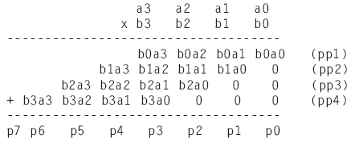
Smaller Multiplier
We learned how to build a multiplier earlier
  Problem: size
32-bit multiplier would have 1024 gates here ...
a3
a2
a1
a0
b0
pp1
b1
pp2
0
0
b2
+ (5-bit)
pp3
0
0
b3
+ (6-bit)
... and 31 adders here (big ones, too)
pp4
0
0
0
+ (7-bit)
p7..p0

Slide 20
Sequential Multiplier
Add-and-shift multiplier
  Don’t compute all partial products simultaneously
  Rather, compute one at a time (similar to by hand), maintain running sum
Step 1
Step 2
Step 3
Step 4
0 1 1 0
0 1 1 0
0 1 1 0
0 1 1 0
+
0 0 1
1
+
0 0
1
1
+
0
0
1 1
+
0
0 1 1
(running sum)
0 0 0 0
0 0 1 1 0
0 1 0 0 1 0
0 0 1 0 0 1 0
(partial product)
+
0 1 1 0
+
0 1 1 0
+
0 0 0 0
+
0 0 0 0
(new running sum)
0 0 1 1 0
0 1 0 0 1 0
0 0 1 0 0 1 0
0 0 0 1 0 0 1 0

Slide 21
Sequential Multiplier
multiplier
multiplicand
Design circuit that computes one partial product at a time, adds to running sum
  Note that shifting running sum right (relative to partial product) after each step ensures partial product added to correct running sum bits
multiplicand
register (4)
load
0110
mdld
multiplier
4-bit adder
Controller
register (4)
m
r
ld
load
0011
mr3
mr2
mr1
mr0
00010010
rsload
load
00100100
rsclear
clear
running sum
01001000
rsshr
shr
register (8)
00110000
00000000
Step 1
Step 2
Step 3
Step 4
0 1 1 0
0 1 1 0
0 1 1 0
0 1 1 0
+
0 0 1
1
+
0 0
1
1
+
0
0
1 1
start
+
0
0 1 1
0 0 0 0
0 0 1 1 0
0 1 0 0 1 0
0 0 1 0 0 1 0
(running sum)
+
0 1 1 0
+
0 1 1 0
+
0 0 0 0
+
0 0 0 0
(partial product)
0 0 1 1 0
0 1 0 0 1 0
0 0 1 0 0 1 0
0 0 0 1 0 0 1 0
(new running sum)
product

Slide 22
Step 1
Step 2
Step 3
Step 4
0 1 1 0
0 1 1 0
0 1 1 0
0 1 1 0
+
0 0 1
1
+
0 0
1
1
+
0
0
1 1
+
0
0 1 1
0 0 0 0
0 0 1 1 0
0 1 0 0 1 0
0 0 1 0 0 1 0
(running sum)
+
0 1 1 0
+
0 1 1 0
+
0 0 0 0
+
0 0 0 0
(partial product)
0 0 1 1 0
0 1 0 0 1 0
0 0 1 0 0 1 0
0 0 0 1 0 0 1 0
(new running sum)

Slide 23
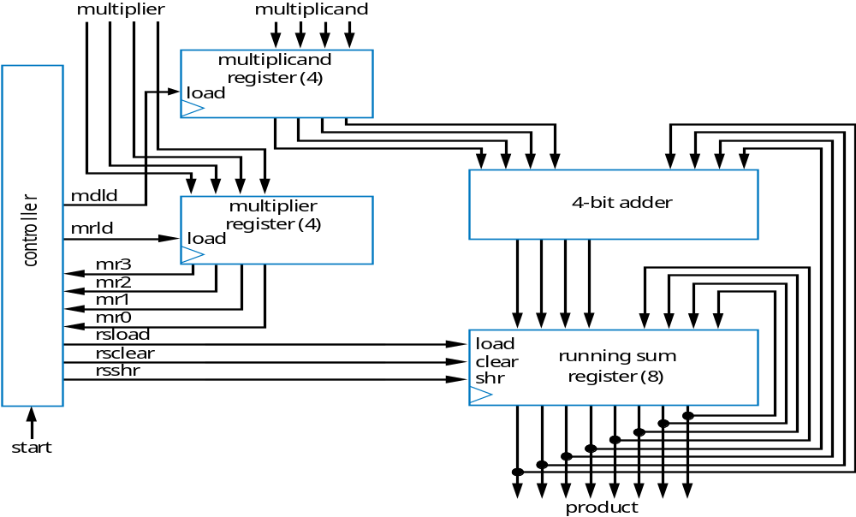
Sequential Multiplier Controller
controller
Vs. array-style:
Pro: small
  Just three registers, adder, and controller
Con: slow
  2 cycles per multiplier bit
  32-bit: 32*2=64 cycles (plus 1 for initialization)
start’
mdld
start
m
r
ld
mdld = 1
mr3
mrld = 1
mr2
rsclear = 1
mr1
mr0’
rsshr=1
mr1’
rsshr=1
mr2’
rsshr=1
mr3’
rsshr=1
mr0
rsload
mr0
mr1
mr2
mr3
rsclear
rsshr
rsload=1
rsload=1
rsload=1
rsload=1
sta
r
t
Wait for start=1
Looks at multiplier one bit at a time
  Adds partial product (multiplicand) to running sum if present multiplier bit is 1
  Then shifts running sum right one position
0110
0011
01100000
10010000
00110000
00010010
00000000
00100100
01001000
Step 1
Step 2
Step 3
Step 4
0 1 1 0
0 1 1 0
0 1 1 0
0 1 1 0
+
0 0 1
1
+
0 0
1
1
+
0
0
1 1
+
0
0 1 1
Correct product
0 0 0 0
0 0 1 1 0
0 1 0 0 1 0
0 0 1 0 0 1 0
(running sum)
+
0 1 1 0
+
0 1 1 0
+
0 0 0 0
+
0 0 0 0
(partial product)
0 0 1 1 0
0 1 0 0 1 0
0 0 1 0 0 1 0
0 0 0 1 0 0 1 0
(new running sum)

Slide 24
Today’s Objective
To learn how to build faster but bigger (or smaller but slower) datapath components
  Carry lookahead adder
  Add-and-shift multiplier

